Slide 1
Fitness Buddy
CAPSTONE PROJECT
Presented By: Snehal Jadhav
Student name : Snehal Jadhav
College Name & Department : Marathwada Mitra Mandal’s College of Engineering, Computer Engineering Department

Slide 2
OUTLINE
Problem Statement
Technology used
Wow factor
End users
Result
Conclusion
Git-hub Link
Future scope
IBM Certifications

Slide 3
Problem Statement
In today’s fast-paced world, many individuals struggle to maintain a healthy lifestyle due to lack of personalized guidance, time constraints, and inconsistent motivation. Traditional fitness solutions often require expensive subscriptions, in-person consultations, or rigid schedules that don't adapt to personal preferences or daily routines. There is a growing need for an accessible, friendly, and intelligent virtual assistant that can provide on-demand fitness advice, healthy lifestyle suggestions, and basic nutrition guidance—all tailored to individual needs and available at any time.
Proposed Solution: Fitness Buddy is a conversational AI assistant created using IBM Watsonx Assistant (Generative AI). It interacts with users to understand their fitness goals and preferences, then provides customized workout plans, healthy meal ideas, and motivational tips—all via a simple web-based chat interface.

Slide 4
Technology used
IBM Watsonx Assistant (Generative AI)
Generative AI response steps
MCQ-style onboarding questions
Web-based deployment via IBM Assistant preview

Slide 5
IBM cloud services used
IBM Watsonx Assistant (Next-Gen)
IBM Cloud Account with Lite Plan
Web-based deployment through Assistant Preview Link

Slide 6
Wow factors
Personalized workout & meal suggestions from AI
No coding needed – built entirely with Watsonx Assistant UI
Seamless chat interface with button-based MCQs
Easily deployed using IBM Assistant’s web preview

Slide 7
End users
Fitness Enthusiasts
Home Workout Beginners
Busy Professionals
Students
Anyone looking for healthy lifestyle support

Slide 8
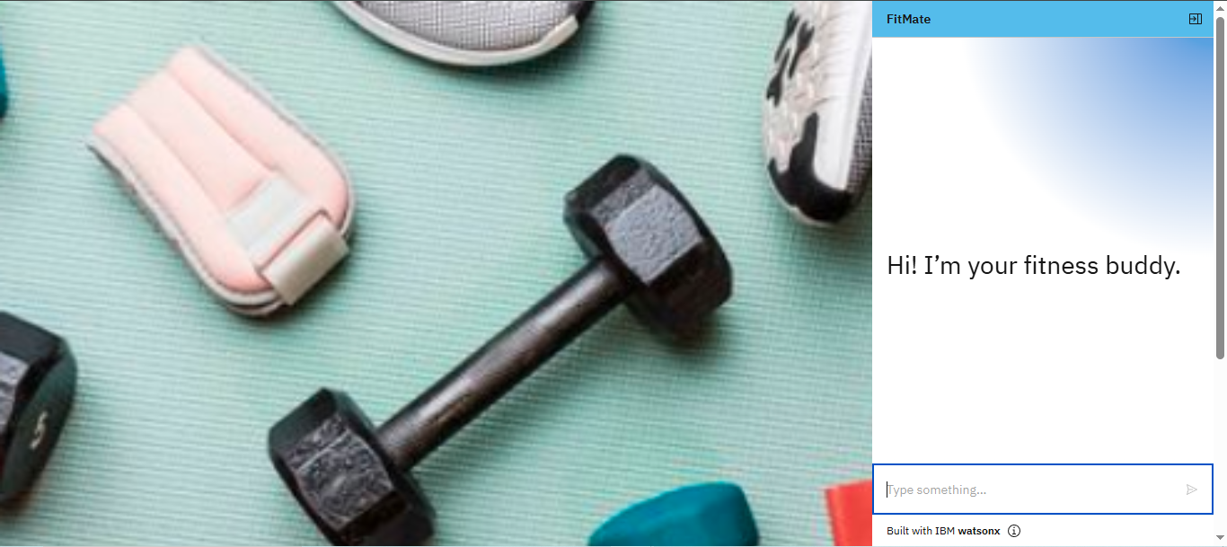
Results

Slide 9
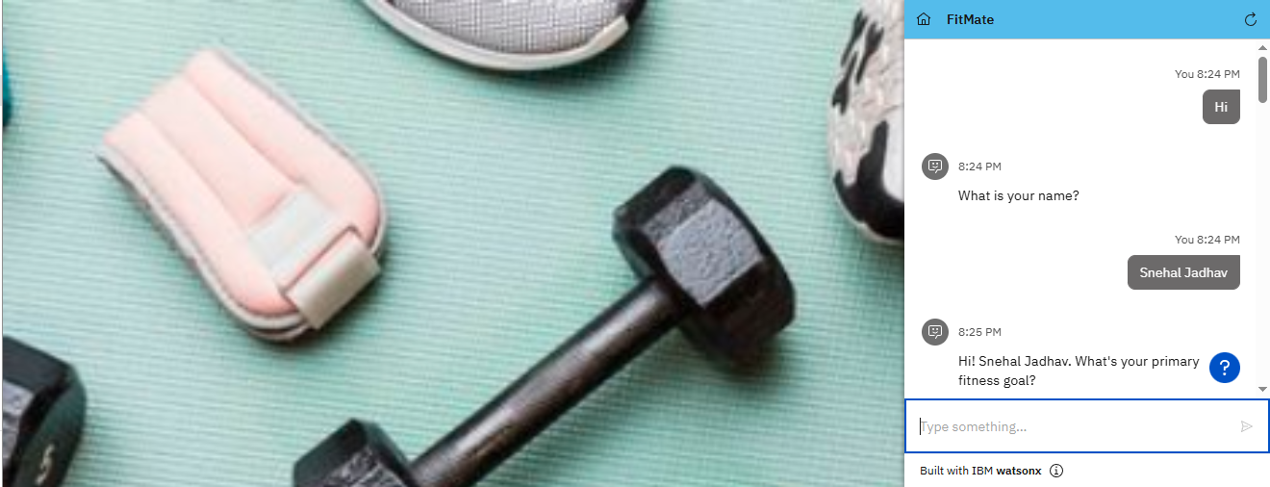
Results

Slide 10
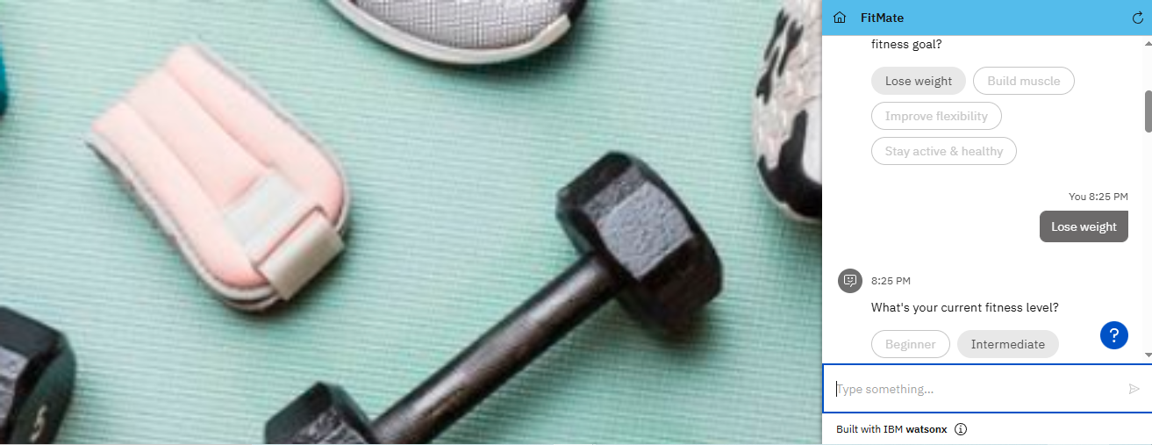
Results

Slide 11
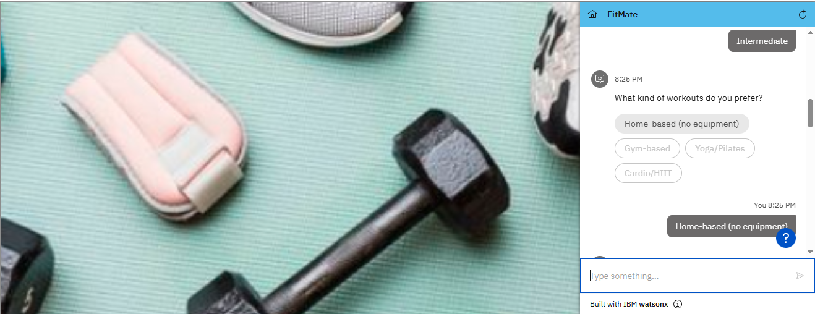
Results

Slide 12
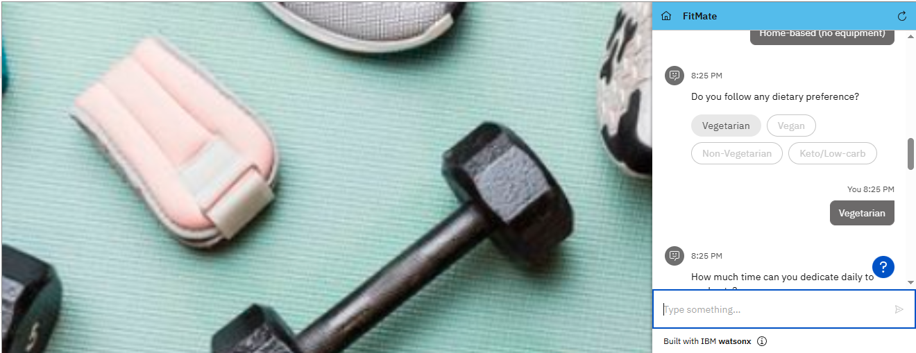
Results

Slide 13

Results

Slide 14

Results

Slide 15
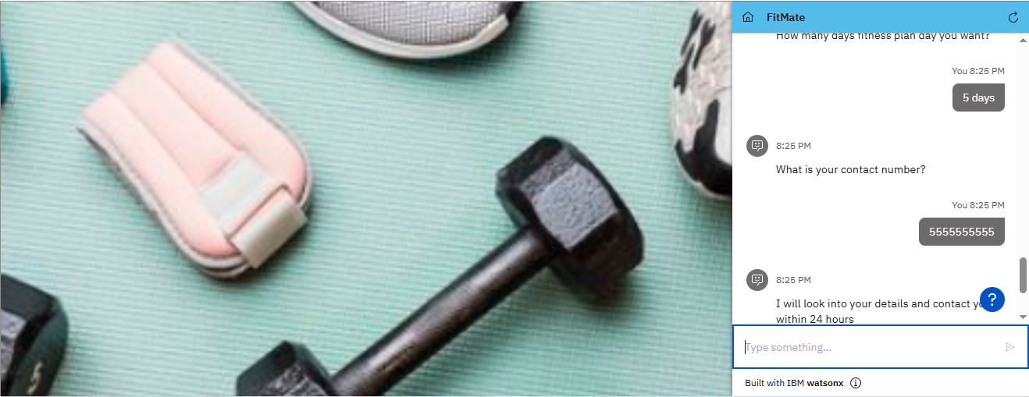
Results

Slide 16
Conclusion
Completed a fully working AI assistant using IBM Watsonx Assistant
Collected user preferences via guided onboarding
Provided dynamic replies using generative AI steps
Published and tested via IBM Assistant web preview link

Slide 17
Future scope
Connect to Telegram or Facebook Messenger
Add user data storage for history tracking
Introduce habit streaks and reminders
Translate into local/regional languages
Expand to include mental wellness and sleep tips

Slide 18
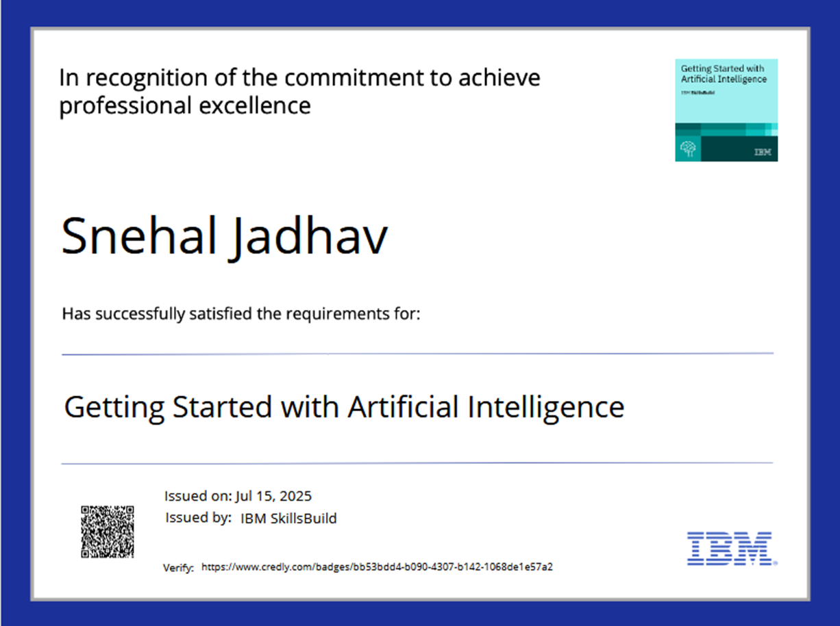
IBM Certifications

Slide 19
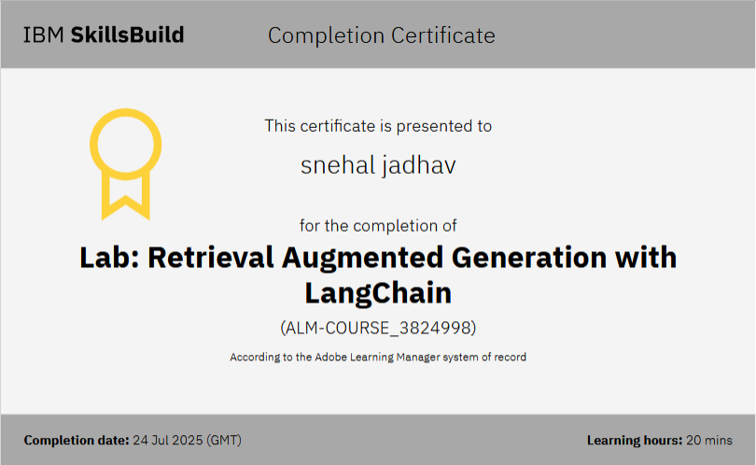

Slide 20
GitHub Link
Git hub link :

Slide 21
THANK YOU

